Slide 1
21AIE113 INTRODUCTION TO ELECTRONICS
TERM PROJECT

Slide 2
BATCH A TEAM 15
P. KOMAL SAI ANURAG(CB.EN.U4AIE21039)
UDAYAGIRI VARUN(CB.EN.U4AIE21071)
SEJAL SINGH(CB.EN.U4AIE21061)
P.S.S.SAI.KEERTHANA(CB.EN.U4AIE21038)

Slide 3
Q-1
Study the working of a Wien Bridge Oscillator

Slide 4
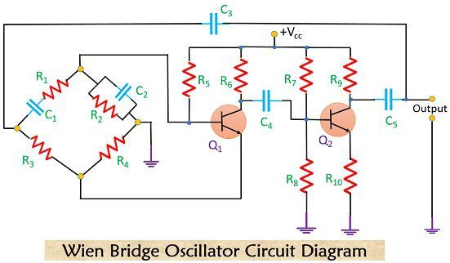
WIEN BRIDGE OSCILLATOR:
Wien Bridge Oscillator is an oscillator which uses RC network so as to produce a sine wave at the output.
These are basically the low-frequency oscillator that generates audio and sub audio frequency that ranges between 20 Hz to 20 KHz.
This oscillator circuit uses the Wien bridge to provide feedback with the desired phase shift. It gives highly stable oscillation frequency and does not vary much with supply or temperature variation.

Slide 5
WORKING OF WIEN BRIDGE OSCILLATOR:
The circuit is set in oscillation by any random change in base current of transistor Q_{1.}
The collector circuit of transistor Q1 amplifies this variation in base current, but with a 180° phase shift.
Through capacitor C4, the output of transistor Q1 is fed to the base of the subsequent transistor Q2.
The output signal will be in phase with the signal input to the base of transistor Q1 after being inverted twice.
Transistor Q2's output signal includes some feedback to the bridge circuit's input points (point A-C)

Slide 6
This feedback signal is partially applied to emitter resistor R4, (which is in negative feedback).
Similar to this, a portion of the feedback signal is applied across base-bias resistor R2, where it has a positive feedback.
By simultaneously changing the two capacitors C1 and C2, it is possible to achieve the oscillator's continuous frequency variation.

Slide 7
Advantages
Delivers a stable, low-distortion sinusoidal output across a broad frequency range.
A decade resistance box can be used to choose the frequency range.
It is simple to change the oscillation frequency by simultaneously changing the capacitances C1 and C2. Two transistors are the reason why the overall gain is so high.
Disadvantages
Two transistors are required for the circuit, along with numerous other components.
The amplitude and phase-shift properties of the amplifier limit the maximum frequency output.

Slide 8
Q-2
Come up with specific designs for each oscillator circuit to generate corresponding sinusoids.

Slide 9
For generation of the sinusoidal wave, we use two type of circuits
1. Wein bridge oscillator
2. RC phase shift oscillator
As we discussed about the Wein bridge oscillator, now we will see about the RC phase shift oscillator.

Slide 10
RC PHASE SHIFT OSCILLATOR:
One of the many AC oscillator circuits that can be adjusted to a variety of loads is an RC phase shift oscillator.
By applying feedback through subsequent RC networks, this circuit generates a clear sine wave with adjustable frequency.
These circuits are extremely stable, and the amount of jitter in the amplifier circuit will determine the phase noise in the output.
Ideally a simple RC network is expected to have an output which leads the input by 90º.
There are 2 types of RC phase shift oscillators:
Using BJT
Using OP-AMP

Slide 11
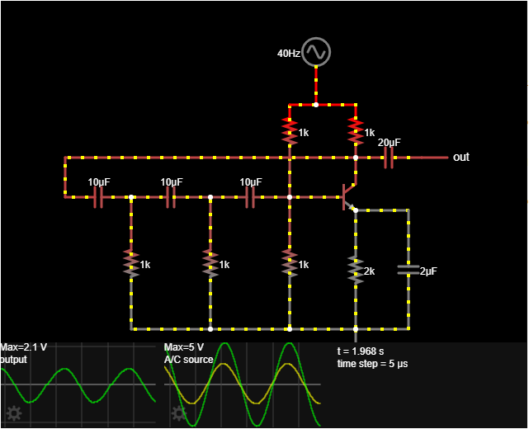
Design of RC phase shift oscillator with BJT:

Slide 12
Working:
By stacking three 3-RC phase shift networks, each of which offers a 60⁰ phase shift, the following RC phase shift oscillator circuit using BJT can be created. The collector resistor, or RC, in the circuit blocks the transistor's collector current.
The o/p waveform will rotate 180⁰ as a result of this connection as it travels from the o/p terminal to the base terminal of the transistor. ​
Due to the fact that the phase difference between the input and the output in a common emitter (CE) configuration can be 180º, this signal can then be rotated 180º again with the help of a transistor within the network. ​
This will fulfil the phase disparity condition and increase the network phase disparity to 360⁰

Slide 13
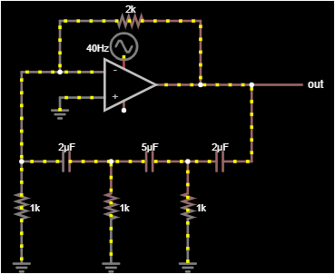
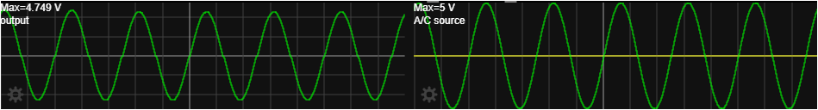
Design of RC phase shift oscillator using OP-AMP:

Slide 14
WORKING:
As implied by its name, an RC phase shift oscillator makes use of the phase shift that happens in an RC circuit during discharge.
Usually, an op-amp wired with feedback, much like a comparator, is used in these circuits.
There will be a phase shift in the output voltages of the circuit's subsequent RC stages as they charge and discharge as the circuit output increases.
As a result of the charging and discharging in subsequent RC networks, an oscillation is created.
It should be noted that the feedback loop of an RC phase shift oscillator could contain any number of RC networks.
This type of circuit analysis is made easier by the fact that these circuits are typically constructed with equal values for all of the resistors and capacitors.

Slide 15
Q-3
Design a Clipper to generate a square wave from the above generated sinusoid wave.

Slide 16
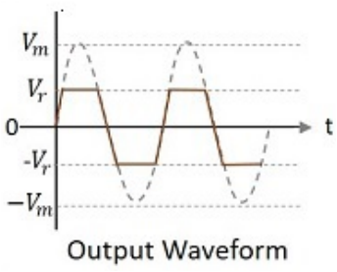
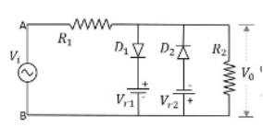
CLIPPER CIRCUIT:
CLIPPER CIRCUIT:
Here, as we are asked to generate a square wave from a sine wave we need to use a dual clipper to clip both the half cycles.
DUAL CLIPPER
The figure below shows the circuit arrangement for a two-way or a combinational clipper circuit along with its output waveform.

Slide 17
WORKING OF DUAL CLIPPER CIRCUIT:
This is a positive and negative clipper with a reference voltage V_{R}.
The input voltage is clipped two-way both positive and negative portions of the input waveform with two reference voltages.
For this, two diodes D₁ and D₂ and along with two reference voltages V_{R1} and V_{R2} are connected in the circuit.
This circuit is also called as a Combinational Clipper circuit.

Slide 18
During the positive half of the input signal, signal, the diode D₁ conducts making the reference voltage V_{R1} appear at the output.
During the negative half of the input signal, signal, the diode D₂ conducts making the reference voltage V_{R1} appear at the output.
Hence both the diodes conduct alternatively to clip the output during both the cycles. cycles.
The output is taken across the load resistor. With this, we are done with the major clipper circuits.

Slide 19
Design an appropriate diode based clipping circuit which generates a square wave from a sinusoidal signal generated from a Wien Bridge Oscillator.

Slide 20
CIRCUIT DIAGRAM

Slide 21
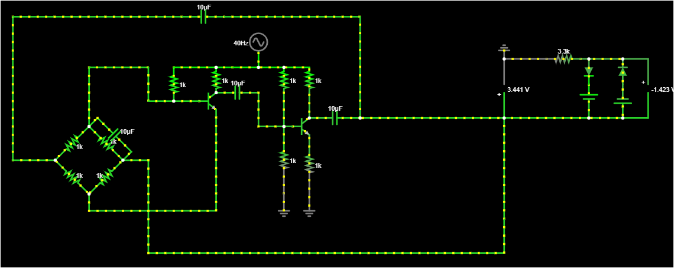

Slide 22
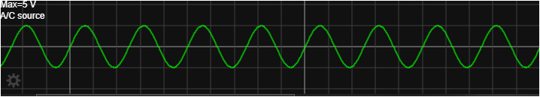
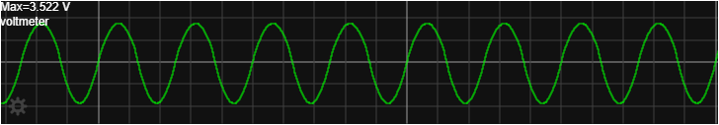
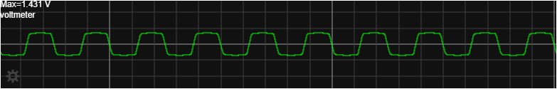
Input and Output Waveforms:

Slide 23
VIDEO PRESENTATION LINK
https://amritavishwavidyapeetham-my.sharepoint.com/:v:/g/personal/cb_en_u4aie21039_cb_students_amrita_edu/EcfgOmcDzQdKk7cYLSFw7oYByfmpkvbeiQ4vtYQ7SWxibg?e=ALHEGy

Slide 24
THANK YOU

